Slide 1
Challenge 5 Development of Dependency Aware Linux Ker­nel based Fuzzer. Author: Puja Dutta, Founder Shivit Infi Pvt Ltd

Slide 2
FUZZING
Fuzzing is a powerful testing technique where an automated program feeds semi-random inputs to a tested program. The intention is to find such inputs that trigger bugs. Fuzzing is especially useful in finding memory corruption bugs
Historically things like libjpeg, libpng and libyaml were perfect targets. Instead of choosing a userspace target lets take the case for Linux Kernel netlink machinery.
Netlink is an internal Linux facility used by tools like "ss", "ip", "netstat". It's used for low level networking tasks - configuring network interfaces, IP addresses, routing tables and such. It's a good target: it's an obscure part of kernel, and it's relatively easy to automatically craft valid messages.

Slide 3
Approach to the problem
We'll run AFL fuzzer, driving our netlink shim program against a custom Linux kernel. All of this running inside KVM virtualization.

Slide 4
Coverage-guided fuzzing -it works on the principle of a feedback loop: -the fuzzer picks the most promising test case -the fuzzer mutates the test into a large number of new test cases -the target code runs the mutated test cases, and reports back code coverage -the fuzzer computes a score from the reported coverage, and uses it to prioritize the interesting mutated tests and remove the redundant ones -For example, let's say the input test is "hello". Fuzzer may mutate it to a number of tests, for example: "hEllo" (bit flip), "hXello" (byte insertion), "hllo" (byte deletion). If any of these tests will yield an interesting code coverage, then it will be prioritized and used as a base for a next generation of tests.

Slide 5
Kernel code coverage
The kernel has at least two built-in coverage mechanisms - GCOV and KCOV:
Using gcov with the Linux kernel
KCOV: code coverage for fuzzing
-KCOV was designed with fuzzing in mind, so we'll use this.
-KCOV is capable of recording code coverage from the whole kernel. It can be set with KCOV_INSTRUMENT_ALL option.
-Disadvantages : it would slow down the parts of the kernel we don't want to profile, and would introduce noise in our measurements (reduce "stability").
-Today, we focus on netlink machinery, first we enable KCOV on whole "net" directory tree.

Slide 6
Feeding KCOV into AFL
The next step is to learn how to trick AFL.
AFL sets up an array of 64K 8-bit numbers - "shared_mem" or "trace_bits" and is shared with the traced program. Every byte in the array can be thought of as a hit counter for a particular (branch_src, branch_dst) pair.
It's important to notice that AFL prefers random branch labels, rather than reusing the %rip value to identify the basic blocks. This is to increase entropy - we want our hit counters in the array to be uniformly distributed.
The algorithm AFL uses is:
cur_location = <COMPILE_TIME_RANDOM>;
shared_mem[cur_location ^ prev_location]++;
prev_location = cur_location >> 1;

Slide 7
Fuzzing NetLink
netlink_fd = socket(AF_NETLINK, SOCK_RAW | SOCK_NONBLOCK, buf[0]);
struct sockaddr_nl sa = {
.nl_family = AF_NETLINK,
.nl_groups = (buf[1] <<24) | (buf[2]<<16) | (buf[3]<<8) | buf[4],
};
bind(netlink_fd, (struct sockaddr *) &sa, sizeof(sa));
struct iovec iov = { &buf[5], buf_len - 5 };
struct sockaddr_nl sax = {
.nl_family = AF_NETLINK, };
struct msghdr msg = { &sax, sizeof(sax), &iov, 1, NULL, 0, 0 };
r = sendmsg(netlink_fd, &msg, 0);
if (r != -1) {
/* sendmsg succeeded! great I guess... */ }

Slide 8
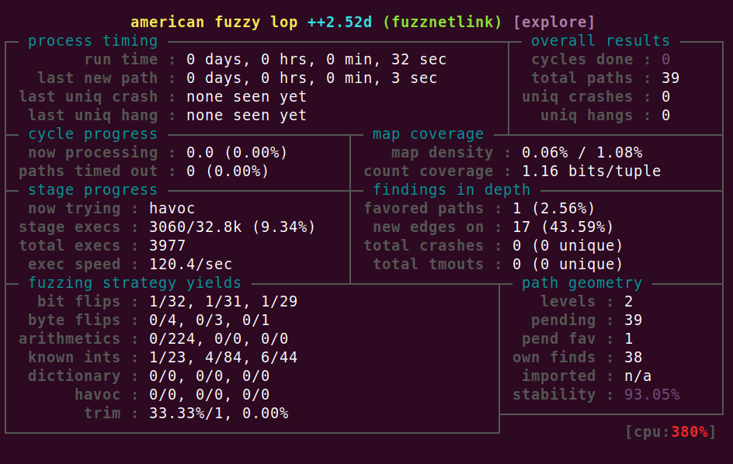
With this running we will see the familiar AFL status screen:

Slide 9
Another Approach to the problem
syzkaller (aka syzbot) by Dmitry Vyukov, is a very powerful CI-style continuously running kernel fuzzer, which found hundreds of issues already. It's an awesome machine - it will even report the bugs automatically!
Reference : https://github.com/google/syzkaller/blob/master/docs/syzbot.md
Trinity Fuzzer : https://github.com/kernelslacker/trinity
Linux Key retention service: https://blog.cloudflare.com/the-linux-kernel-key-retention-service-and-why-you-should-use-it-in-your-next-application

Slide 10
Thank You

